Slide 1
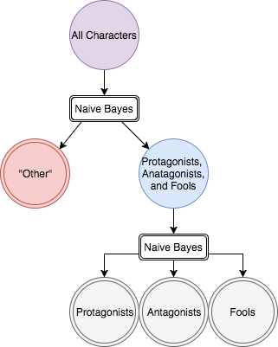
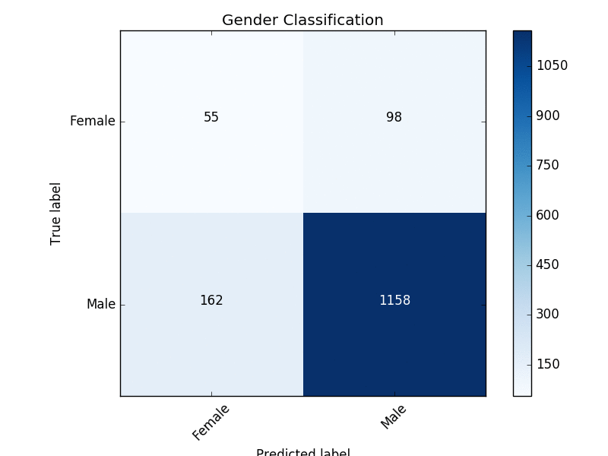
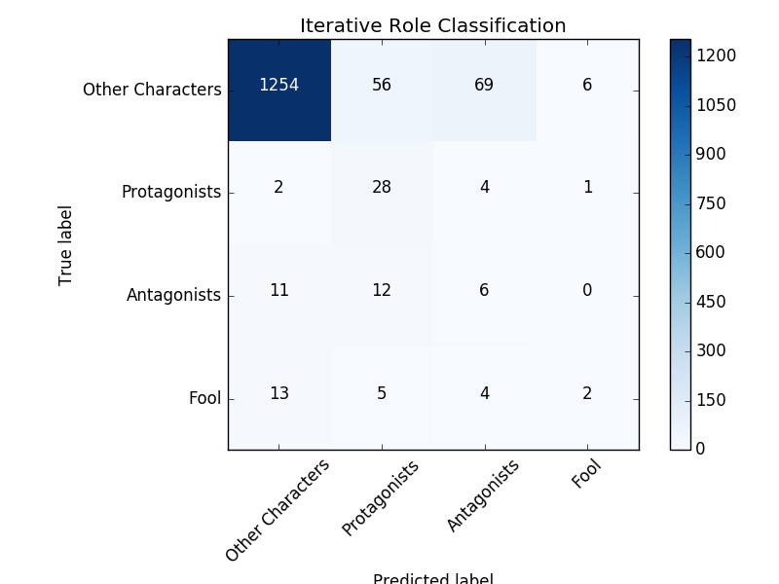
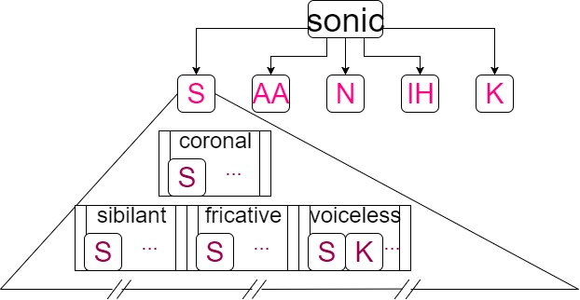
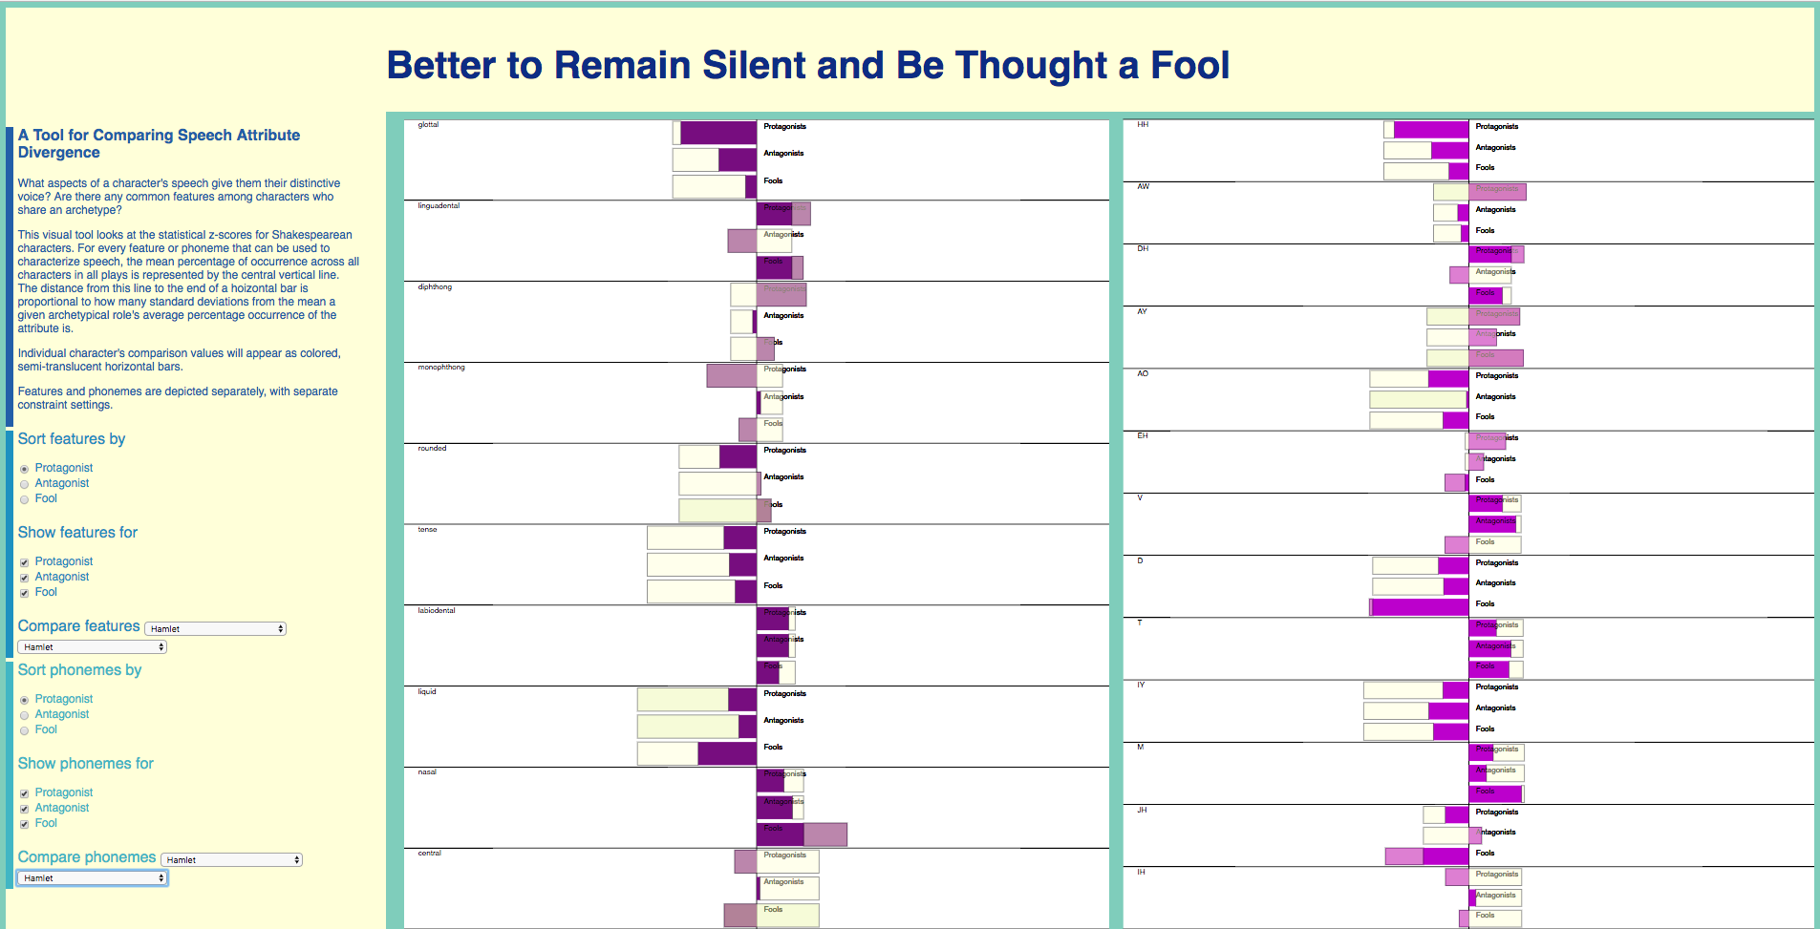
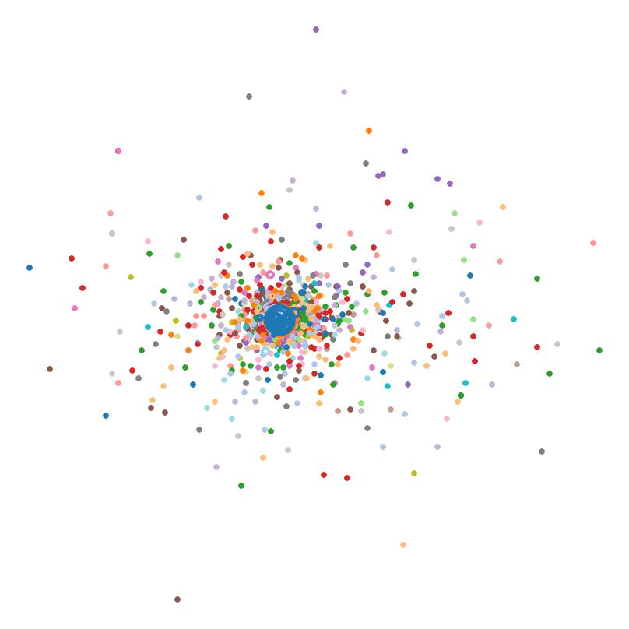
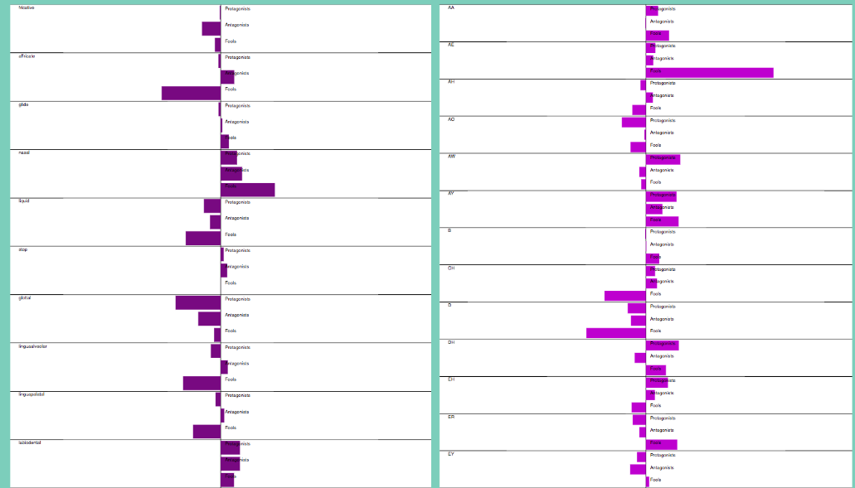

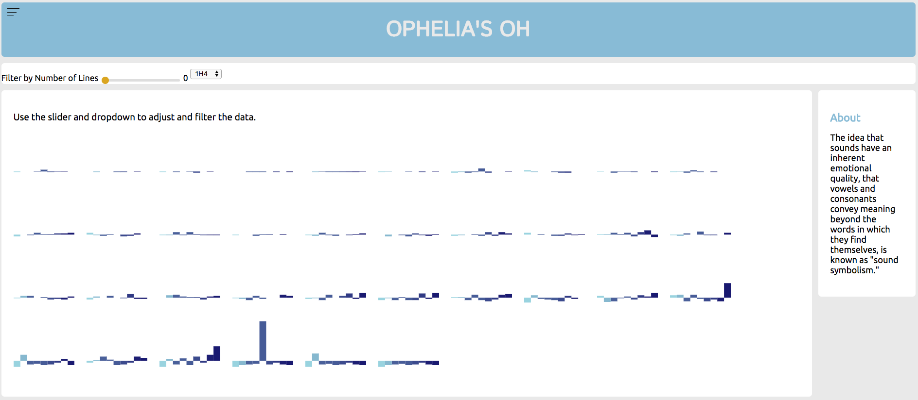
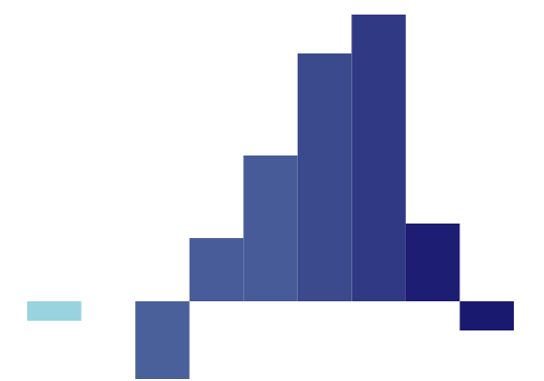
Sonic Signatures: Do Shakespeare’s Characters Have Distinct Speech Qualities?
Estelle Bayer, Liz Nichols, Eric Alexander
Computer Science, Carleton College
Why Sonic Signatures?
Naïve Bayes Classification
The sounds that make up a word are thought to have meaning.
When researchers make up gibberish words for objects, people tend to agree on which gibberish words should refer to small and large objects.
When close reading a poem, readers pay attention to assonance and consonance and draw meaning from the repetition of sounds.
Is it then possible to visualize how a character “sounds”?
Do female characters have a different sound pattern than male characters?
Do protagonists sound different from antagonists?
Are characters differentiable from one another based on how they sound?
Having extracted phoneme and feature data, we wanted to see if simple classifiers could use these data to differentiate between different types of characters.
The iterative Bayes classification was performed through first filtering out any character classified as “other” before re-classifying the remaining characters as antagonists, protagonists, or. Fools
Highest success was achieved when training data was weighted by number of speaking lines, and role determination was done iteratively. The classification results for gender are comparable to previous results based on text analysis, and
the role classification was particularly successful at filtering out “other” characters and identifying protagonists.
Quantifying “How Characters Sound”
The iterative naïve Bayes process yields more useful results in highly unbalanced data sets
Confusion matrix resulting from weighted naïve Bayes classification of gender
Confusion matrix resulting from weighted iterative naïve Bayes classification of role
Words break down into a set of fundamental elements called phonemes. Every phoneme has an associated list of features which describe the physical processes necessary to produce it. We analyzed characters using the types of sounds they made and the specific sounds they made.
The word “sonic” decomposes into five distinct phonemes.
Z-Score Comparisons
Do certain speech attributes occur with higher frequency than average among specific archetypes?
Once we established standards for specific roles, we wanted a way to visually compare the deviation from norm for any given character to those norms.
The interactive z-score visualization allows users to sort features and phonemes by descending order of significance for a role; view only certain roles; and view the distance between a character’s z-scores and the averages for a role.
The phoneme “S” has the features that it is coronal, sibilant, and fricative, among other features.
Depicting Features
We turned each character’s speech into a vector and used multidimensional scaling to look for groups of characters.
An incomplete view of the basic view of z-score data for phoneme and features of archetypical roles, without any comparisons
A partial view of the comparison between Hamlet’s Hamlet and the standards for all archetypes
A multi-dimensional scaling, color-coded by play and with number of lines encoded as size of bubble.
What Next?
“Ophelia’s Oh”
Preview attachment Screen Shot 2017-08-18 at 3.44.53 PM.png
Screen Shot 2017-08-18 at 3.44.53 PM.png
6.9 KB
Preview attachment Screen Shot 2017-08-18 at 3.46.01 PM.png
Screen Shot 2017-08-18 at 3.46.01 PM.png
11 KB
Beyond Shakespeare:
Expand our analysis to other authors, not limited to playwrights
or anglophones, with a particular interest in the role of verse and prose. Does the significance of sonic signatures change across form and language?
Word Choice Covariance:
Previous work has shown that word-based analysis yields promising categorization results, so do sonic signatures provide unique features, or merely reflect the same information as the words they comprise? To what degree are sonic signatures covariant with word choice in determining classification?
Stanley Newman, in his experiments in Sound Symbolism, scaled vowels from bright to dark in how subjects perceived them. “IH” as in “Lit” sounded brightest, while “UH ” as in “Put” sounded darkest and biggest.
We wanted to examine which characters, if any, tended toward bright or dark vowels, so bars below the line represent below average usage of a vowel, while bars above the line represent above average usage of a vowel. Brightly colored bars represent brightly scaled vowels, while dark bars are dark vowels.
This tool allows us to see at a glance that certain characters do, indeed, have “brighter” or “darker” overall characterization to their speech.
Claudio
Rosalind
References
Scikit-learn: Machine Learning in Python, Pedregosa et al., JMLR 12, pp. 2825-2830, 2011.
Olson M. Determining the gender of Shakespeare’s characters. Stanford University[Internet]. 2013.
Bird, Steven, Edward Loper and Ewan Klein (2009), Natural Language Processing with Python. O’Reilly Media Inc.
Folger Shakespeare Library. (n.d.) Shakespeare's Plays, Sonnets and Poems from Folger Digital Texts. Retrieved from www.folgerdigitaltexts.org
To the left are two distinctive sonic signatures that one might compare using the tool – Rosalind and Claudio. At a glance you can see quickly that one has dark bars above the line and one has dark bars below the line.
Thank you to Carleton College, Eric Alexander, and Mike Tie for supporting this research

